Slide 1
Potato Disease Classification

Slide 2
Problem Statement
Farmers who grow potatoes suffer from serious financial standpoint losses each year which cause several diseases that affect potato plants. The diseases Early Blight and Late Blight are the most frequent.Early blight is a disease of potato caused by the fungus Alternaria solani. It is found wherever potatoes are grown. The disease primarily affects leaves and stems, but under favorable weather conditions, and if left uncontrolled, can result in considerable defoliation and enhance the chance for tuber infection.Late blight caused by the Phytophthora infestans is the most important disease of potato that can result into crop failures in a short period if appropriate control measures are not adopted.Early blight is caused by fungus and late blight is caused by specific micro-organisms and if farmers detect thisdisease early and apply appropriate treatment then it can save a lot of waste and prevent economical loss. The treatmentsfor early blight and late blight are a little different so it’s important that you accurately identify what kind ofdisease is there in that potato plant.Our Goal is to classify the the type of disease in the potato plant Thus, we have three classes
Healthy
Early Blight
Late Blight

Slide 3
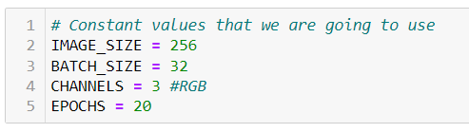
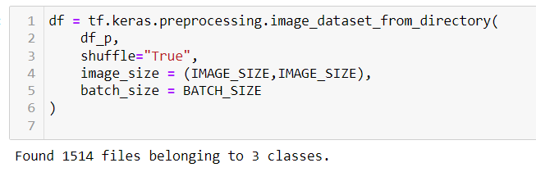

Slide 4
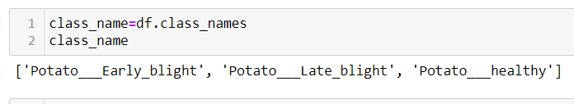
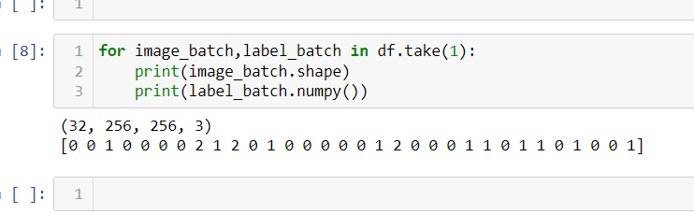

Slide 5
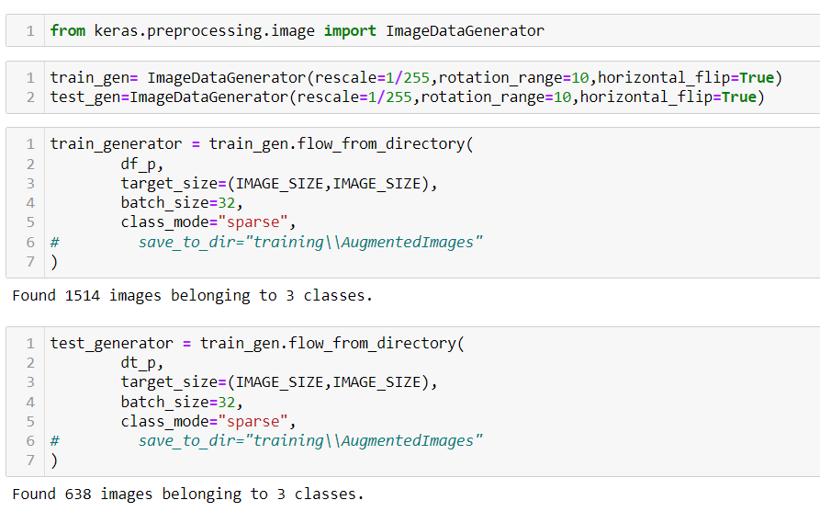
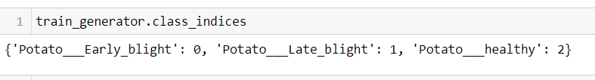

Slide 6
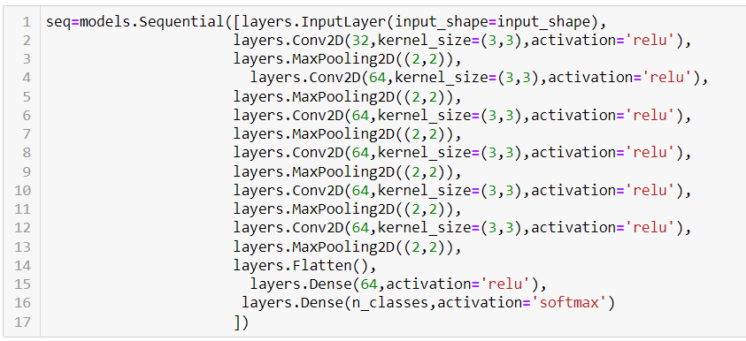
Model building

Slide 7
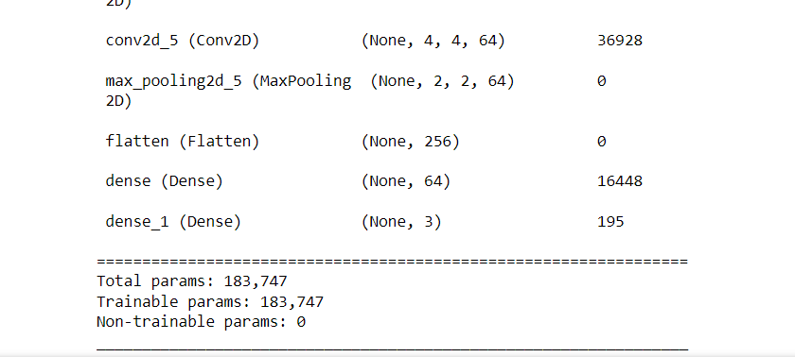
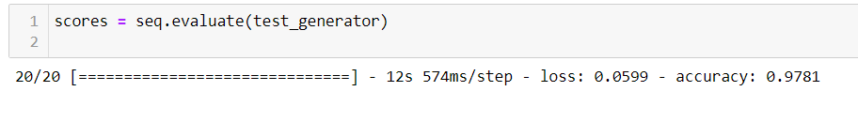
Evaluation

Slide 8
You can see above that we get 97% accuracy for our test dataset. This is considered to be a pretty good accuracy

